Slide 1
Working of Spyware and Antispyware
Prof Sharada Valiveti

Slide 2
Contents
Introduction
Detection Escapism
Invading Privacy
Hijacking home page and search pages
Working of dialers
Working of key loggers and root kits
Following spyware money trail
Working of anti-spyware

Slide 3

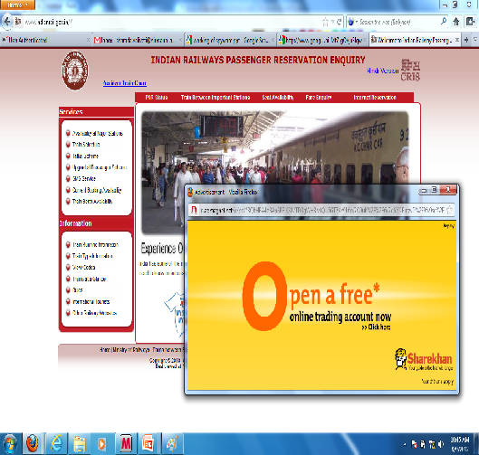
Adware

Slide 4
Introduction
Program capable of
Monitoring ones’ actions
Sometimes they are sinister
Software companies use Spyware to gather data about customers
Symptoms
Targeted Pop – Ups
Slow Connection
Targeted Email (Spam)
System Crash
Program Customization
Adware Vs. Spyware

Slide 5
Introduction
Spyware
Is commercially motivated
Requires Internet Connection
Initiates Remote Connection
Is created to monitor activity
Collects data and displays pop ups
Is legal
Is not detectable with virus checker
Is relatively new

Slide 6
Introduction
Threats
Volume far outstrips spam and regular virus infections
Spyware usually refuses to be uninstalled through your control panel
Covertly install themselves on your computer
Perform secret operations without your permission

Slide 7
Detection Escapism
Polymorphic spyware
Web Search and About:Blank home pages morphing
If the anti-spyware deletes the spyware, copy of itself is spawned elsewhere in hard disk
Spyware injects itself into process running on PC
Secretly spawning into a program and running at the background
Burrowing into computer registry

Slide 8
How spyware invades the PC?
Monitors surfing habits and reports to server
Key-logger
Instals malicious software like Trojans etc.
Home Page hijacker
Changes the home page so that all activities are routed to some other server
Pops up many windows
Changes the default search engine to track user behaviour
Also add themselves in toolbar as add-ons

Slide 9
Case Study
Dialers
Keyloggers
Have two parts - .exe and .dll
Rootkits
Sony
Installs background daemon
Also install keyloggers or sniffers that record
Capable of modifying computer’s system log

Slide 10
Working of Antispyware
Use signatures for spyware detection
When such signature is found, it checks its own database for match
If match is found, it concludes as spyware infection
Suspicious behaviour
Not all anti-spyware can delete all spyware
Includes real-time protection

Slide 11
Thank you!!!
Queries??

